Slide 1

Correlation of Profit and Sales from year 2015 - 2018
In US States

Slide 2

Disscount

Slide 3
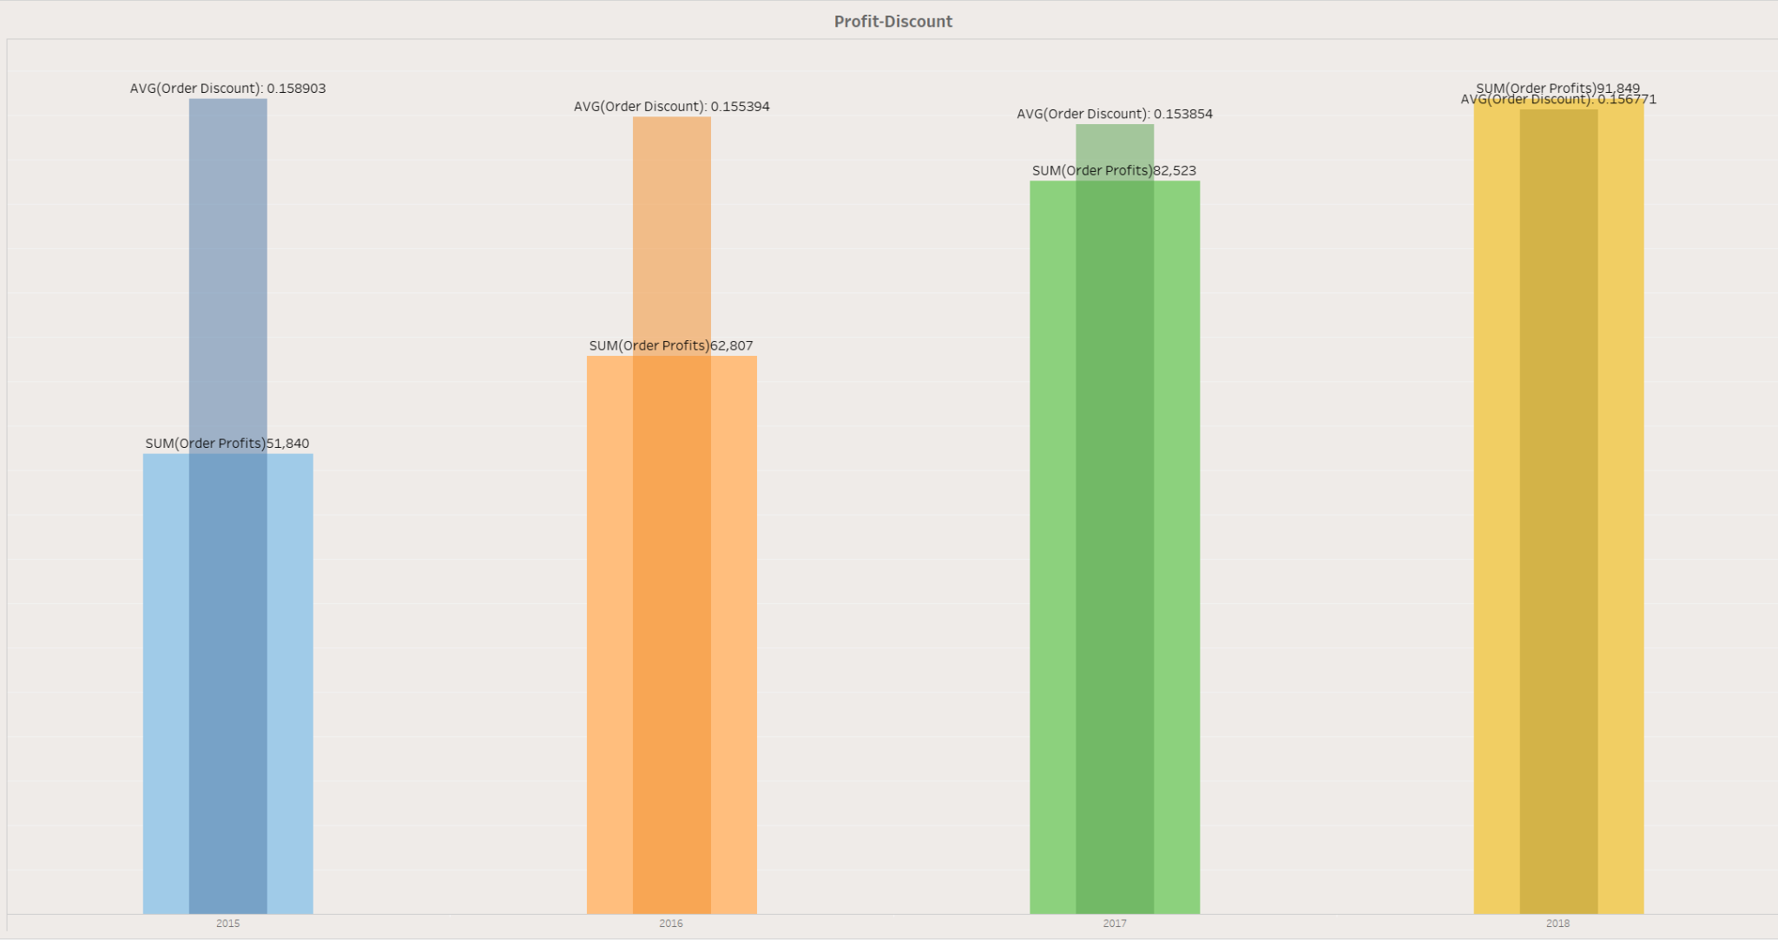

Slide 4
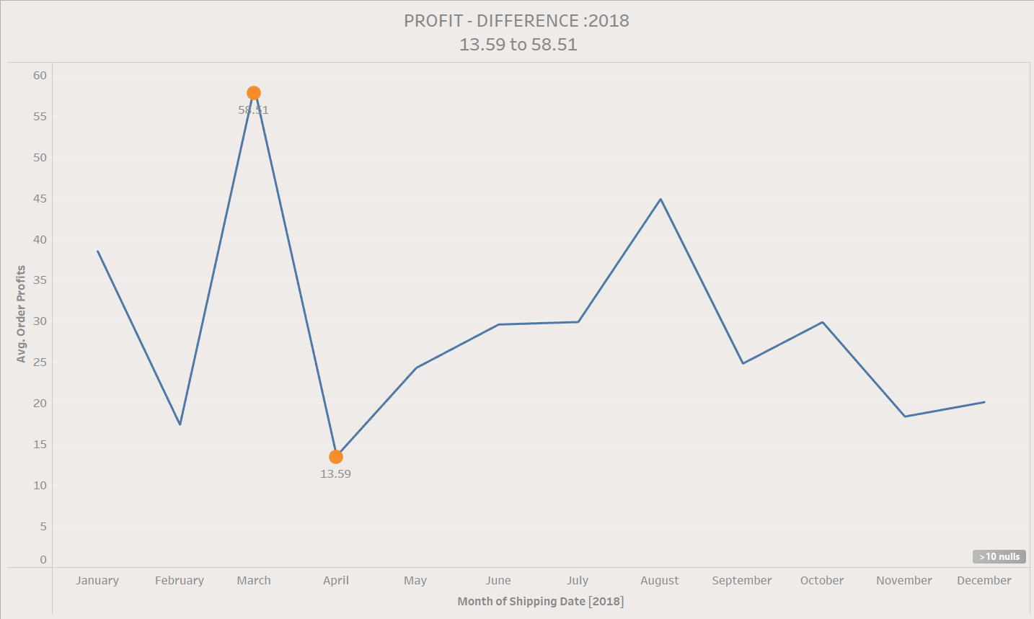

Slide 5
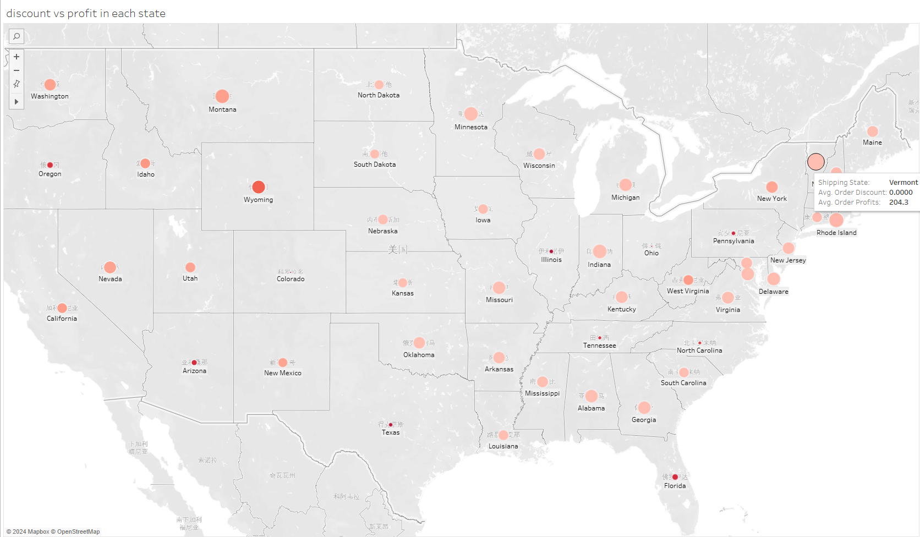

Slide 6
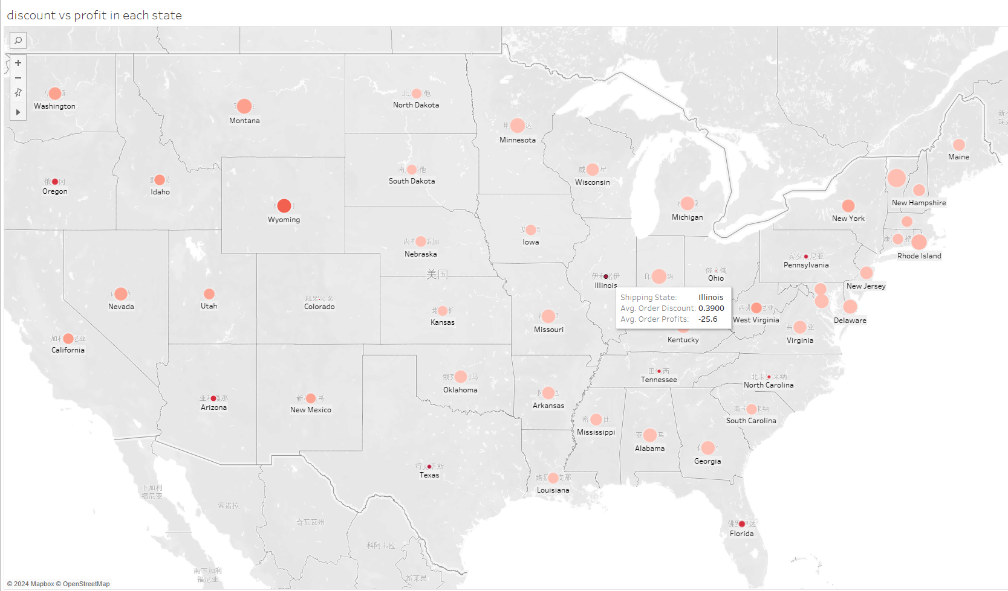

Slide 7


Slide 8
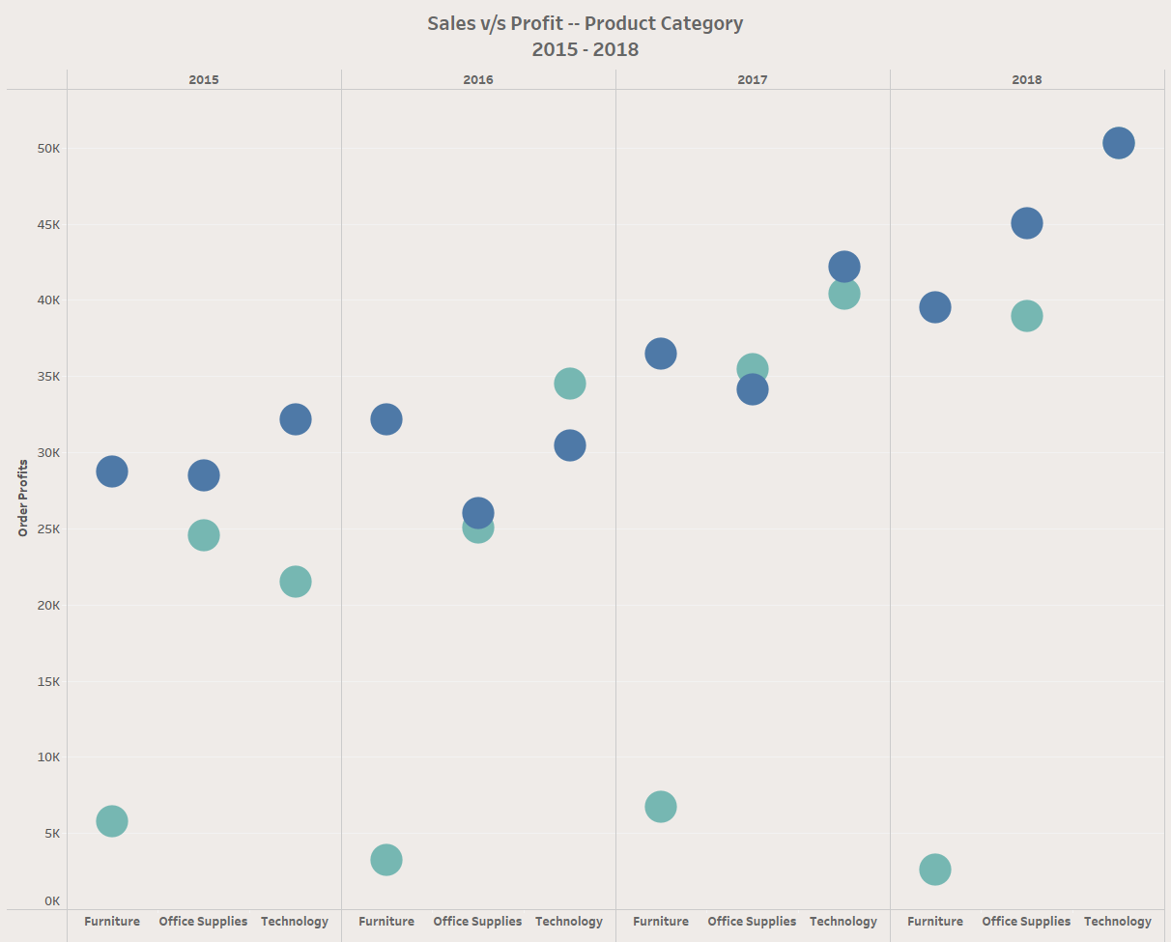

Slide 9
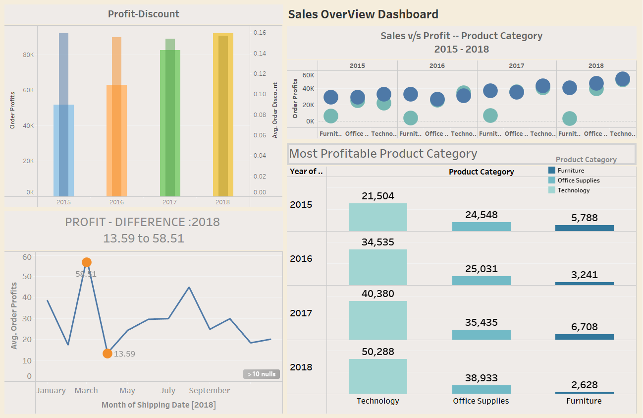

Slide 10
Technology
-The highest selling items in this category are phones
-> Most of technology products are office equipment and complementary products to office computer

Slide 11
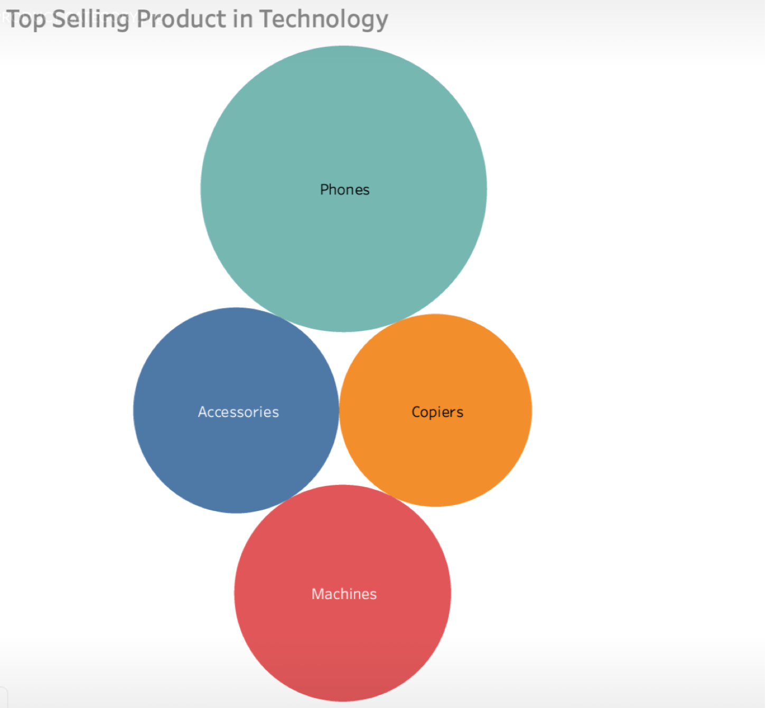

Slide 12
Recommendations - Maximizing Profit
-focus on the strong local establishments and reputation in profit earning states
-enhanced local relations to boost quarterly sales across different items
-expand the current business coverage to broader area (such as schools, or charities associations)

Slide 13
Recommendations - Discount Scheme
-Standalone products discount should be review and offer it on a quota basis
-Discount should be provided to complementary products in a bundle sales with the purchase of main product (eg. printer ink should be given discount when printer is purchased in the same order)
-Discount should only be offer to customer that showing a good or healthy credit repaying trend based on previous transactions.

Slide 14
Thank you for your kind attention!
By: Group 1
Saira Aslam
Jia Xin, Lee
Rolf Chung
Claude Li
Hanumanth Baba Kumbhar

